Slide 1
Can COVID response redirect focus of European housing systems?
Covid-19 Global Housing Policies Project Housing Research Collaborative with UBC and University of Ottawa
Dr Julie Lawson, Centre for Urban Research, RMIT
Julie.lawson@rmit.edu.au

Slide 2
Impact of COVID-19 in Europe
Enormous impact on European’s health and social and economic wellbeing.
16 250 376 cases; the five countries reporting most cases are France (2 127 051), Russia (2 089 329), Spain (1 556 730), United Kingdom (1 493 383) and Italy (1 380 531).
368 554 deaths; the five countries reporting most deaths are United Kingdom (54 626), Italy (49 261), France (48 518), Spain (42 619) and Russia (36 179) (as of 23 November 2020).
Variation in outcomes, Finland best health and housing outcomes so far – important to understand why.
High housing costs and tenure

Slide 3
Pre-covid European settings - reset needed
Asset based welfare via home ownership - low interest rates, credit norms, household debt, economic instability dominant role of mortgages in bank lending, strong expansion EUR 7.25 trillion outstanding residential loans
EU and member states have relied on rising housing prices to fuel GDP growth (often facilitated by tax incentives), but has consequences for affordability, indebtedness, inequality and crisis. A high rate of credit extension increases risk of a financial crisis (Jorda et al, 2016).
Direct link between house prices, total credit growth influenced by weak bank regulation and low interest rate policies, together promoting over-indebtedness. Procyclical and instability effects – boom, bust, crises. Under first Basel accord, the risk weighting of house mortgages was substantially less (half ) of loans to companies, affordability tests internally developed and applied by lenders.
Growth of asset manager capitalism, Morgan Stanley Blackrock etc. Rise (and falter un UK) of REITs and revenue driven models, targeting large portfolios, affordable and supported rental housing.
Wage growth surpassed by growth in house prices. Reliance on private rental sector, offering varying protection.
Limits of monetary policy. Ideally a financial system can support good growth mobilizing investment and allocating capital appropriately; but Basel accords and ECB has not been able to fulfill this ideal. Accelerated investment in existing RE assets by global funds and promoted exit of public banks as long term lenders in social housing.
Stability and Growth Pact, Services in the General Economic Interest and Competition policy
EU stance has accelerated privatisation and narrowing purpose of public and not for profit housing systems

Slide 4
International guidance for Recovery
Do differently than past financial crises
Purposeful investment, sufficiently large, timely and properly designed green stimulus measures can generate economic growth, create jobs and bring about environmental benefits, but policy design and evaluation important (OECD, 2020)
Building Back Better – key policy document for nations designing housing focusing on energy efficiency and inclusive stimulus (OECD, June, 2020)
UN Habitat – SDGs guide plans Covid-19 Policy and Programme Framework
Social inclusion needs to be part of Green Deals – e.g. Address energy poverty and through EC Just Transition Fund – economic diversification of the territories most affected by the climate transition and the reskilling and active inclusion of their workers and jobseekers (EC, 2020)

Slide 5
European Pillar of Social Rights 2017 New leadership team –Green Deal (Timmermans) Temporary framework to face new crisis
Eurogroup (finance ministers of eurozone) permits flexibility in the Stability and Growth Pact to allow governments “to cater for unusual events”.
Temporary Framework will enable Member States to (i) set up schemes direct grants (or tax advantages) up to €500,000 to a company, (ii) give subsidised State guarantees on bank loans, (iii) enable public and private loans with subsidised interest rates.
..but will Pillar of Rights, new flexibility and temporary frameworks help drive more sustainable investment and fairer housing systems?

Slide 6
Varying impact on European housing systems
The pandemic highlighted several key vulnerabilities in our societies, their economies and in particular their housing systems
Major impact on incomes and thus capacity to pay for housing rents and mortgages – potentially exacerbating or introducing affordability, access issues.
Economic stabilisers including housing systems really matter.
Some housing systems more resilient and effective in responding to current crisis – Finland, Denmark and Austria best in class.
Some measures may lead to longer term reforms – improved rent regulation, better tenure choices, green focused investments.
May lead to re-assessment of commercial landlords and re-invigorate role of social housing.

Slide 7
Finland “best” in class for health and housing
The COVID-situation stable - rapid, effective control, low spread, effective testing and few deaths (national health statistics).
Good housing conditions: Low share of 5.5m population in overcrowded, in unaffordable housing or at risk of poverty (social pillar indicators)
Early stimulation of economy (eur 20 billion package) and foresees no future austerity measures.
Very rapid automatic stabilizers – unemployment, housing benefits and other social security .
Social assistance of last resort raised with 75 €/month for most needy households.
Very flexible lay-off systems, employees don’t lose work. Rapid unemployment benefits and housing benefits also, if and when needed.
Banks allow postponed mortgage payments.
Evictions postponed (in new law)
SH production increased from 7,800 to 9,000 new starts in 2020 (30% more new loans with interest subsidies)
Guidelines for social landlords how to guarantee housing also followed by private landlords (feedback from ARA)
Rent revenues secure. Tenants more timely with rents! More need for counselling and some agreements made on rent arears (feedback from landlords)

Slide 8
Finland - doing well also as countercycle
Best COVID health and housing outcomes in Europe
Addressing homelessness
Youth independence providing pathways
Top for social inclusiveness
Multi-player social sector
9,000 supplied p.a (22%)
16 % of market
Broad based access
Continuum of affordable housing provided by public and private LPHAs
Land is rented not purchased, cost capped where subsidies sought. Tenant provider pays discounted land tax.
Central Agency ARA
10-50% conditional grants
Credit analysis Guarantees and targetted interest rate subsidies for approved loans
Social criteria defined
Cross sector legislation
Limited Profit Housing LPH
Rents vary by area portfolio costs
Covers ammortisation and services in area
Rent assistance if and when required
Lowsest cost long term financing
90% MUNI FIN
Public financial intermediary
Ammortising loan
Updated from Lawson, Pawson et al (2018) AHURI
Notes:
As in other forms of infrastructure, public investment in social housing is declining in Australia and the sector is moving towards a mixed model of investment.
Yet, as we know commercial debt has proved limited, short term and costly.
Towards more cost effective debt, the bonds model was proposed and NHFIC will soon be established.
Building on this chosen pathway, Finland represents best practice in financial intermediation and the next step along this route – funding the gap. There, the supply and allocation of affordable housing remains an important goal of government – across the spectrum from homelessness to social housing, shared equity and home ownership.
Finland uses a straight forward approach balancing conditional public investment of variable grants with lowest cost publicly raised and guaranteed bonds and well-targeted housing allowances and regulation on providers to provide a continuum of housing services for Finnish households.
Various housing loans, interest subsidies and grants are financed from an off-budget fund called the Housing Fund of Finland. The off-budget fund receives cash from interest payments and amortization of existing state housing loans and additionally from external funding. It is a kind of future fund for housing.
It is substantially more effective version of proposed Growth Funds in NSW and Victoria and as thus could complement an established HFIC.
Central is the specialist role of Finland Housing Finance and Development Centre (ARA) which monitors needs and procurement costs, regulates providers, approves their financing costs and provides subsides.
It offers a cliding scale of grants – 10% to 50% depending on complexity
The Guarantee and Interest subsidy is only provided on approved loans within the interest rate cap.
Debt is raised off budget from the debt capital markets via the Municipal Finance Corporation, which also fiinances all local infrastructure in Finland – it is a pubic infrastructure banks.
Clarity of regulation of providers public and not profit under Limited Profit Law
Cost rent Limited profit 8% must be reinvested new supply
Relies on land rent rather than ownership.
Together ARA and Munifin together constitute one of the most effective social housing systems in Europe in terms of preventing and reducing homelessness and providing a continuum of housing options for households neglected by the free market.

Slide 9
Austria – resilient system
Like much of Western Europe, Austria has a large and well established limited profit housing sector, which plays a major role in constructing decent affordable housing for rent and ownership.
Early agreement on required health and safety measures between representatives of the building industry, the trade unions and the government allowed building to continue, avoiding a slump and allowing continuity of activity across the supply chain.
It is also a stable employer offering state of the art green construction and management systems that are not only tenant focused but also efficiency driven.
Housing association sector was expected to reach a peak in 2020 with more than 17,000 completions but will spread this work into 2021 to act countercyclically.
Most of limited profit housing association homes are already energy efficient and connected to district heating.
Refurbishment offensive for housing: funds thermal rehabilitation, boiler replacement, and decarbonisation of district and local heating increased considerably. Funds of EUR 750 million, focus on assisting lower-income households to switch to clean heating. Two year program. Also one year program for owners of single-family homes (in rural areas) up to EUR 5,000 grant per home.
Vienna increases affordable housing production with 1000 new apartments

Slide 10
French social landlords aim for green social housing and broaden public interest banking alliance
Social landlords are accelerating the switch to low-emission energy and ensure improvements passed on to tenants further reducing energy related poverty.
Social landlords committed to local low-carbon construction supply chains, scale efficiency and recycling of materials, towards a more circular economy (Union-Habitat, 2020).
Propose a 3-year plan of new production and rehabilitation to preserve nearly 500,000 jobs in the sector > 300,000 housing units and improving 400,000, depending on the capacity of construction companies and their subcontractors and suppliers to meet demand.
In developing the supply of social housing, in particular low income and very low income households, improving the quality of housing and maintaining a high level of urban design (Union-Habitat, 2020).
New #socialhousingalliance for investment formed between CDC, EIB and COEB.

Slide 11
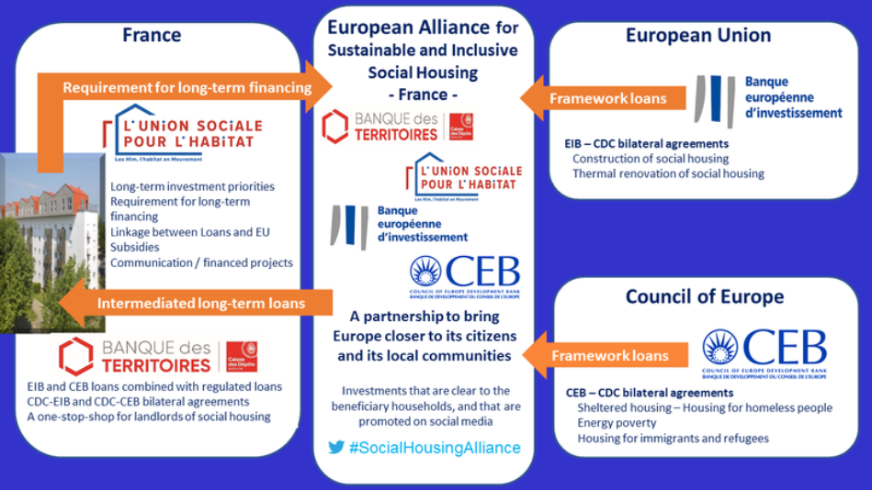
New investment alliance between public interest banks – pre COVID
For details of New European alliance for sustainable and inclusive social housing see: https://coebank.org/en/news-and-publications/news/ensuring-success-european-recovery-plan-france/

Slide 12
Denmark invests own building fund for climate, comfort and jobs
Land policies
Not for profit
Tenant managed
Self financing
Revolving fund
Purposeful and Countercyclical
In Denmark, the government proposes to allocate DKK 30 billion (€4 billion, A$6.5 billion) for green renovations in the social housing sector as a first step towards their green recovery (Ourhomesourdeal, 2020).
The Danish program aims to lift the standard of older properties to reach contemporary energy standards, insulating exterior walls, rooves and ceilings and replacing old windows for energy windows, to make substantial heat savings (between 30 and 40%).
The proposal also has the potential to substantially increase housing affordability and reduce energy poverty.
Furthermore, due to economies of scale, renovations can facilitate more accessible homes for the elderly and disabled people.
Builds on previous efforts. Since 2003, the social housing sector in Denmark has delivered more than 15,700 accessible homes.
By 2020 aims to provide 3,300 full-time jobs in the construction sector and 7,800 in 2021.

Slide 13
€4billion allocated forward for green renovations
Source: Noring (undated) Financing the Inclusive City
See also https://www.ourhomesourdeal.eu/post/green-recovery-for-denmark

Slide 14
Germany protects renters but court challenges remain.. referendum also looms.
Following expiry of public loans and large scale municipal privatisation, rent regulation system has had varying degrees of influence on rental stock. Role of large landlords Vonovia, Deutsche Wohnen has increased.
Due to rising rents since 2014, Berlin rent cap introduced late 2019, just prior to pandemic. Since November 23 overpriced rents must be reduced or landlords face fines.
National eviction ban also enacted 2020
Allowed severely affected tenants to postpone rent payments for the months of strict lockdown 2020
National mortgage relief also enacted 2020
Return of national government to supports local government 4.9 billion euros in boosting social housing schemes.
Despite rent cap and pandemic, profits strong and stavble for large corporate landlords as of November 2020
Nevertheless, Deutche Wohnen and Vonovia continue their campaign to overturn Berlin’s rent regulation in the courts.
Counter campaign to expropriate Deutche Wohnen attracts 57,000 votes enabling referendum.

Slide 15
Looking Ahead – Housing 2030 and EC Affordable Housing Initiative
.
#Housing2030 - a tool kit for policy makers on land, finance, governance, environmental standards – to be launched in 2021. https://www.housing2030.org/
European Commissions Renovation Wave will progress.
Hear EC VP Frans Timmermans: https://bit.ly/2J4D8zN
The Affordable Housing Initiative (AHI) aims to pilot 100 renovation districts.Creating quality, liveable, affordable homes for people and will mobilise cross-sectoral project partnerships. Developing necessary technical capacity amongst social, public and co-operative housing partners.
Neighbourhood approach for replication, prioritising liveability and innovation.
Via cross-sectoral project partnerships linking them to local actors, including from the social economy, to promote:
efficient, circular and modular processes
social engagement models to empower residents
inclusive and accessible developments
cultural innovation
https://www.ourhomesourdeal.eu/affordable-housing-initiative and Housing Europe’s position - https://4232610a-db1f-486b-890c-9f1a934214d0.filesusr.com/ugd/8ac5c3_33f14bd47a784d458549ef54850143aa.pdf

Slide 16
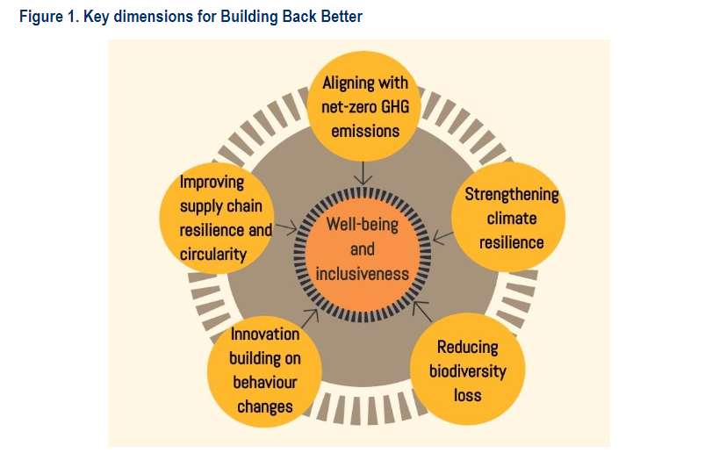
What’s next? Back to business as usual?
Will Recovery Plans be a force for a change in direction?
Or lock economies into the problems of the past?
EU Green Deal potential game changer
Building Back Better, OECD June 5, 2020

Slide 17
Australia - Victoria’s response
State of Victoria most comprehensive
Over $5 billion of direct government investment.
Established own $1billion Social Housing Growth Fund now generating dividends,
Community Housing proposals for $1.38B to deliver 4,200 outcomes. Public corporation NHFIC also guaranteed bond issues long term lower cost financing.
Will also seek contributions of land from local government and buy out distressed developments sites and seek a long term, strategic land supply mechanism.
State government takes responsibility and initiative
Strengthening tenancy rights and dwelling standards
Targeted rent relief
Addressing backlog in social housing repairs and renovation
Strategic investment in housing specifically for vulnerable households affected by COVID19
Major direct public investment expanding affordable housing stock – 4 years, 12,000 houses $5.3 billion.
https://www.vic.gov.au/homes-victoria-big-housing-build

Slide 18
Conclusions
Pre Covid housing investment and regulatory settings ripe for a reset to address affordability and security
Focus in Europe clearly on renovation, energy efficiency, fairness
Finland provides valuable lessons: effective, countercyclical
Economic shock absorbers were in place and rapidly responded
Effective housing system driving adequate, secure and affordable outcomes, able to play its countercyclical role.
Reforms of weaker systems also possible, Victoria provides inspiration for this direction. All eyes on Berlin.
EU Green Deal, Renovation Wave and Affordable Housing Initiative mechanisms for social and environmental reform.

Slide 19
Thank you
Link to report and interactive map
https://housingresearchcollaborative.scarp.ubc.ca/2020/11/13/covid-19-global-housing-policies/
Centre for Urban Research
further contact
julie.lawson@rmit.edu.au

