Slide 1
How can COVID-19 push governments to provide adequate housing? (photo: Arnica Inn,Yellowknife – hotel to homes)
Dr. Carolyn Whitzman
Adjunct Professor, Department of Geography, Environments and Geomatics
University of Ottawa
Canadian Urban Institute
Photo credit: C. Whitzman, East Vancouver

Slide 2
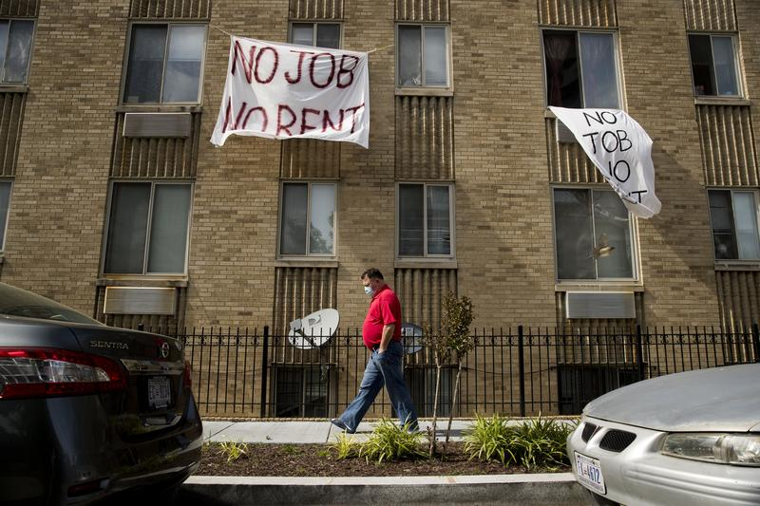
COVID-19 & housing policy (WNYC, Toronto Foundation)
COVID-19 has exposed and exacerbated global housing emergency
Can’t shelter in place without adequate housing (1.6 billion people – 1/3 of urban population – have insecure tenure, overcrowding, lack of access to water/ sanitation)
Economic shut-down - > evictions/ foreclosures (1/2 of Canadian renters have less than a month’s savings) (Tranjan, 2020)
Evidence of increased racial and income-based inequalities in COVID-19 rates, as well as increased global violence against women
Are there any signs that there is “rapid policy making, done well?” in response (Rogers & Power, 2020)
Tranjan, R. (2020). The Rent Is Due Soon: Financial Insecurity and COVID-19 (Ottawa: Canadian Centre for Policy Alternatives).
Rogers, D. and E. Power, Housing policy and the COVID-19 pandemic: the importance of housing research during this health emergency. International Journal of Housing Policy, 2020. 20(2): p. 177-183.

Slide 3
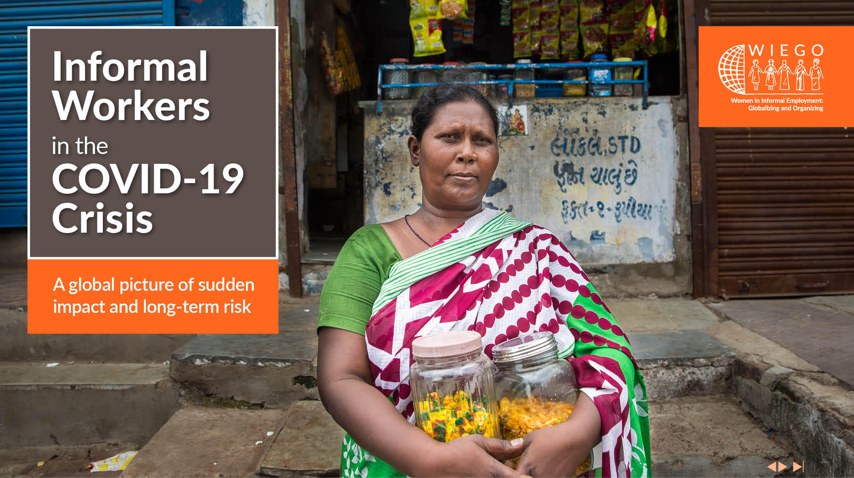
Global Policy Scan/ Roundtables (WIEGO)
Housing Research Collaborative (UBC) funded by Peter Wall Institute for Advanced Studies, undertook a global policy scan Aug-Nov 2020
Academic, policy & media reports “COVID-19” “housing policy”
3 roundtables providing guidance and links:
Canada: Cooperative Housing Federation of Canada, Dr. Martine August (University of Waterloo), Aboriginal Housing Management Association, Canadian Housing Renewal Association, National Right to Housing Network, BC Non Profit Housing Association, Right to Housing Toronto, Canada Mortgage and Housing Corporation
Eastern Hemisphere: Dr. Kate Raynor (University of Melbourne), Right to Housing Aoteoroa, Prof Nicole Gurran (University of Sydney), Dr. Priti Narayan (UBC), Sock-Yong Phang (National University of Singapore).
Western Hemisphere: Prof Ana Falu and Evalia Columbo (Red Mujer y Habitat de America Latina), Drs. Kate Scanlon and David Madden (London School of Economics), Dr. Julie Lawson (RMIT University, Housing Europe), The Shift, Dr. Emily Silverman (Hebrew University), Amy Khare (Case Western Reserve University) and Dr. Albert Abu-Gyamfi (Kwame Nkrumah University of Science and Technology).

Slide 4
Three priorities (UNHCR)
Drawn from The Shift (2020) and from Corburn et al (2020)
(1) dampen the spread of COVID-19 based on the latest available science,
(2) improve the likelihood of health outcomes for those most marginalised, whether or not they have COVID-19;
(3) improve long-term conditions for those most marginalized by generating adequate housing;
Corburn, J., et al., Slum Health: Arresting COVID-19 and Improving Well-Being in Urban Informal Settlements. Journal of Urban Health, 2020. 97: p. 348–357.
https://www.make-the-shift.org/covid19/

Slide 5
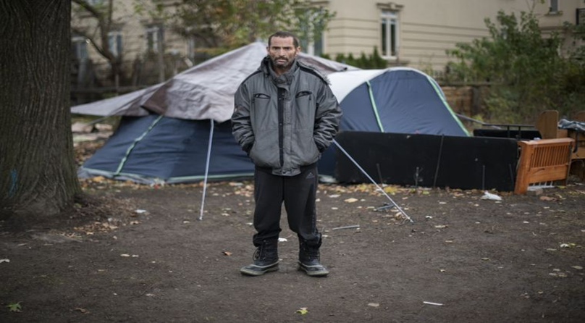
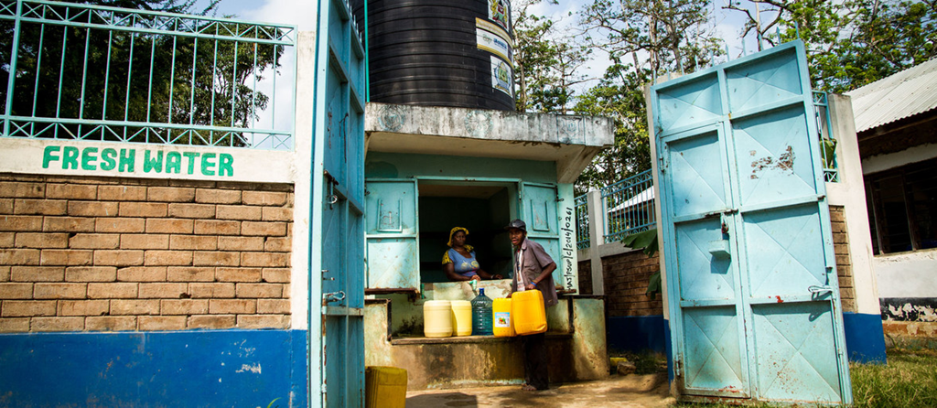
Dampening the Spread (Globe & Mail, UN)
Protection for those living in informal settlements and encampments (adequate water, sanitation, distancing; including responding to the expressed needs of residents)
Protection for those living in shelters and other congregate housing (shared toilets and cooking facilities)
Supporting self-help measures (such as increasing access to water in Brazilian informal settlements, and community resistance to evictions);

Slide 6
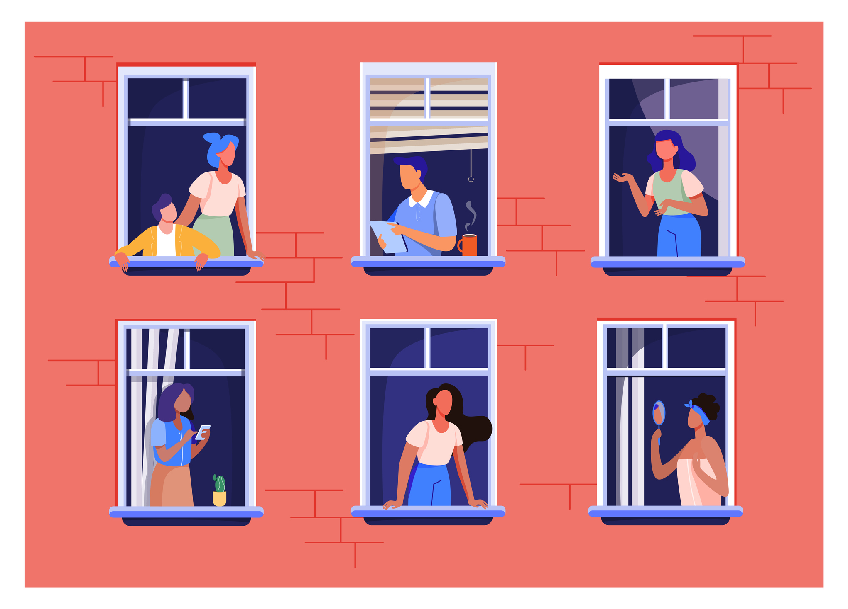
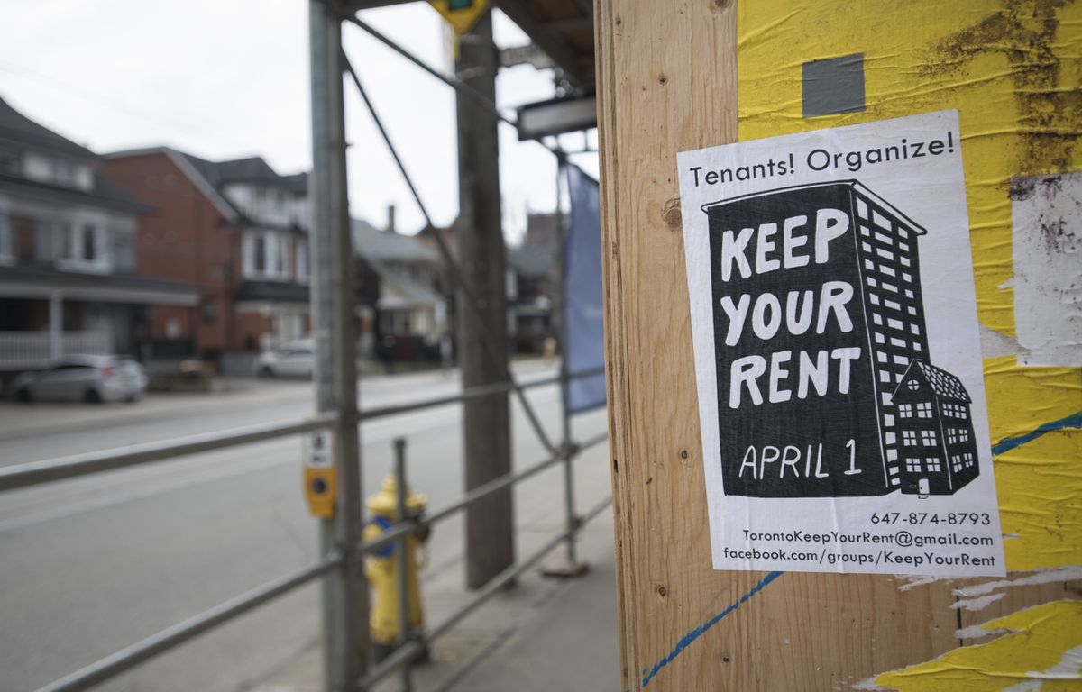
Improving health outcomes of marginalized communities (Wellesley Institute, Globe & Mail)
(4) Protecting renters and mortgage holders from eviction/ foreclosures or utility cut-offs
(5) Financial assistance to renters and mortgage holders with reduced income (including direct rental or income assistance, and assistance with utility payments)
(6) Measures to access justice for housing abuses (including inadequate distancing in shelters, ‘stealth’ or illegal evictions/ foreclosures; independent monitoring of promised government policy for adherence to targets)

Slide 7
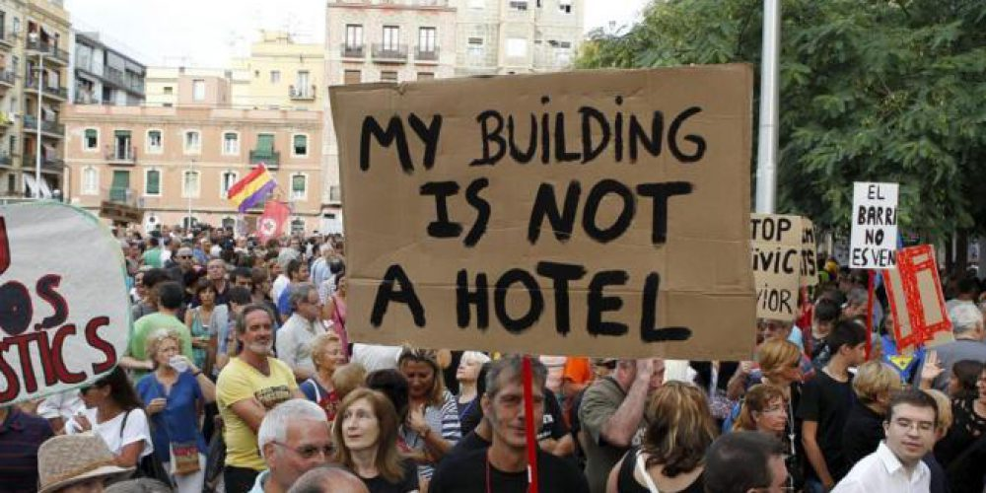
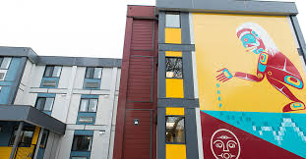
Building Back Better (Barcelona-homes, City of Vancouver)
(7) Better intergovernmental coordination (local, regional, national, First Nations, international)
(8) Acquiring properties and land for social or rent regulated affordable housing
(9) Protecting land and housing from predatory financialization
(10) New or improved strategies: increased targets, funding, or programs for new social and affordable housing, including renovations.

Slide 8
Good Practices (not ‘best’!)
Lessening spread of COVID-19: Temporary distancing in shelters, Govt taking over management of nursing homes. Residents, aided by NGOs and local governments such in Rio de Janeiro, have provided public education and health services, access to water, and emergency funding. All governments should listen to the expressed needs of homeless people and those in inadequate housing and act to improve their health and safety.
Homelessness Prevention: Short-term eviction moratoria, builds up rent or mortgage debt. Better: emergency rent & income assistance, rent freezes, and eviction bans for the entire length of the COVID crisis. Best: rapidly acquiring homes.
Rapidly Securing New Low-Cost Homes: California Bill SB-1079, inspired by activists Moms4Housing, bars sellers of foreclosed homes from bundling them at auction for sale to a single buyer. In addition, it will allow tenants, families, local governments, affordable housing non-profits and community land trusts 45 days to beat the best auction bid to buy the property and has pledged $600 million USD for that purpose; As of July, the City of Barcelona has ordered 14 property groups to let out almost 200 ‘vacant’ flats to city residents in the next 30 days or it will expropriate the properties at 50% of their value and rent them as public housing. State of Victoria, Australia: $5.3 billion social housing building blitz; Canada; $1 billion Rapid Housing Initiative

Slide 9
COVID-19 can become a turning point (CCPA)
In the US, 20 million people are in imminent threat of homelessness.
In Egypt, up to a million households were given an October deadline to pay an application to ‘formalize’ their home or face demolition, even in the face of widespread unemployment.
Globally, COVID-19 has coincided with climate change related disasters such as fires, floods and drought to leave hundreds of millions without homes this year
But Right to Home (11 Canadian cities) have pledged to ‘build back better’
All levels of government must re-assess housing policies and commit to investing to end homelessness and inadequate housing

