Slide 1
City of London Core Area Action Plan
Making A Difference

Slide 2
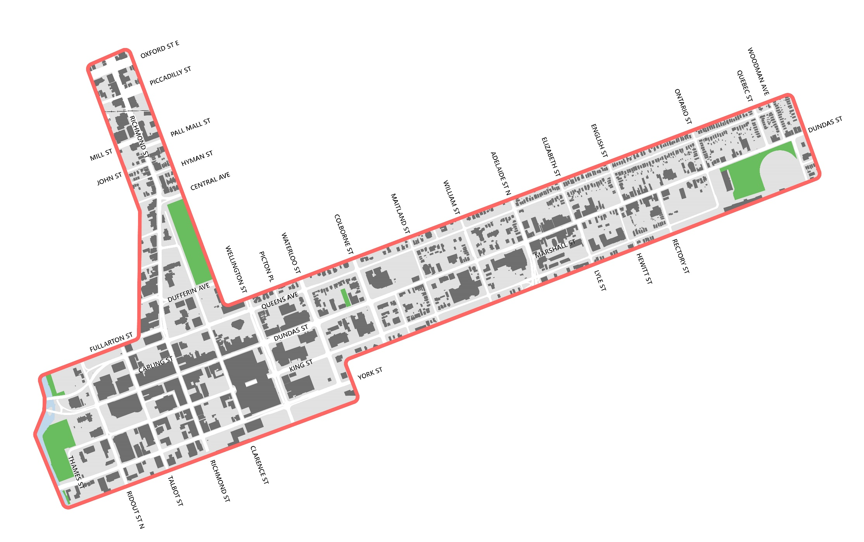
Our Core Area

Slide 3
Our Problem
Despite extensive investment in London’s Core Area, issues persist that threaten its long-term success.

Slide 4
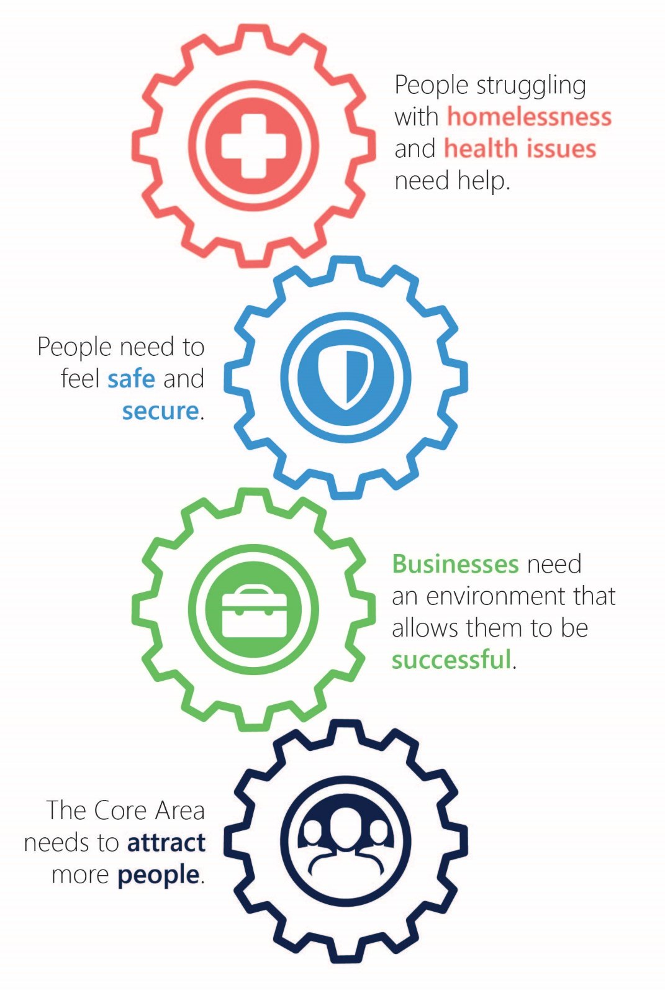
Our Approach

Slide 5
Actions:
Housing stability week
Completed in Oct 2019,Provided intensive and focused support for those suffering from homelessness.
Intensive attempts were made to invite those who are homeless to a large resting area (consistent with the approach used for other crisis events)
Multiple social service agencies supported be on-site and provided a variety of intensive supports and assistance in a coordinated and direct manner.
The goal was to connect each person to the health and housing services they need.
Notes:
Individuals were able to rest, have a shower, receive a meal and shelter.

Slide 6
Actions:
Permanent Coordinated Informed Response
Responding to the challenges experienced by individuals sleeping rough or unsheltered encampments are the main focus of the Coordinated Informed Response (CIR) Program.
The program compassionately works with individuals to find safe locations for them to rest and focus on their needs to maintain housing stability.
Housing First and rapid housing models are being used for participants who choose to work towards transitioning from the street to housing stability.
Individuals who do not choose to seek rapid re-housing are connected with various services and supports depending on their needs in the moment.
Notes:
Additionally, the program focuses on proactive as well as responsive by-law enforcement of encampments on public and private property.
Roadside Operations and Forestry work closely with By-law Enforcement and the Coordinated Informed Response team to provide support by cleaning and maintaining public space in the Core Area.
This includes garbage clean up, syringe pick-up on public property and storage of individuals’ personal belongings.

Slide 7
Actions:
Daytime resting spaces
Multiple daytime program places have been removed in the recent past. This has meant those who could previously access dedicated daytime program indoor spaces are forced to find other locations to spend their day. Public spaces, such as parking lots, underneath bridges, public streets, parks, riverbanks, and alleys are some of those spaces where people have chosen to rest throughout the day.
40 resting space beds have been made available for a mix of daytime (8AM-5PM) and overnight (9PM-7AM) use.
These spaces are matched through a referral process as part of the 24/7 Coordinated Informed Response initiative.
Notes:
Currently
10 beds for women
10 general day space beds
10 general overnight spaces
10 indigenous spaces incorporated into a broader indigenous led response to indigenous homelessness

Slide 8
Actions:
Headlease Program
Many of London’s most marginalized population cannot meet the requirements necessary to sign a lease – due to their history, health condition or background.
For this reason, they can find themselves unable to obtain housing.
This can help to get more people in London, and the Core Area, into the housing they need.
Notes:
The City established a program whereby the City or a partner agency signs the headlease to secure the housing unit for the participant.

Slide 9
Actions:
Supportive housing units
City partnered with a local non-profit developer to create 32 supportive housing units for individuals experiencing homelessness.
Individuals are being matched to units through the City’s Coordinated Access system.
Occupancy is expected in mid-2022.
Notes:
Strengthen Coordinated informed response
Manager
Earlier
Breakfast program

Slide 10
Actions:
Expand case management approach
The Housing First Model emphasizes the need to focus on each individual, assess their housing needs and concurrently assess and understand their additional requirements for personal health and prosperity, such as mental health support, drug addiction counselling, physical health needs, etc.
City has worked collaborative with agencies to establish a case management approach to coordinating the treatment and support of the vulnerable population in the Core Area.
This approach has required that agencies show flexibility to try new methods of strategizing, collaborating and integrating care between organizations that may have different operational and funding priorities.
While sorting through logistical and operational issues has been difficult and is still in progress, the gains in efficiencies, effectiveness and outcomes have supported individuals experiencing homelessness in the City’s core.

Slide 11
A Coordinated Approach
Coordinated Informed Response
New housing with supports
More resting places
Head lease program
Expanded case management
Coordinated Access System for intake, assessment and matching to available housing resources

